Slide 1



APEX and EBR
Zero Downtime (Apex) Application Upgrades
© SYNTEGRIS INFORMATION SOLUTIONS GMBH

Slide 2





APEX and EBR
Author
Sven Weller
www . syntegris.de

Slide 3

EBR Basics
EDITION BASED REDEFINITION
Edition based redefinition
unique feature of the Oracle DB since 11.2 no additional license costs
available in EE, SE1, SE2, XE
store and run different versions of PLSQL based objects AT THE SAME TIME
editionable objects | non editionable objects
Packages, Functions, Procedures | Tables, Columns, Data
Trigger | Sequences
Types, Type Bodies | Indexes
Views, Editioning Views | Materialized Views
Libraries | Database Links
Synonyms | Public Synonyms
Virtual Columns | Function Based Indexes

Slide 4
EBR Basics
USAGE
child can “inherit” objects from the parent edition “inherit” will break, the first time the child compiles an
object
a database session is attached to a specific edition users work in one session/edition
a new application release is deployed in a second edition
after some grace period (testing time), default edition is switched
next time user logs in, he/she works in the new edition
ORA$ BASE
ED1
ED2

Slide 5


Demo 1
EDITION SETUP
make schema editionable create editions
switch editions code something
DBA_setup_editions.sql

Slide 6
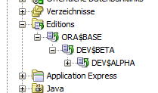
Edition as a Service
CONNECT TO EDITION
DB services are different names for a database Can set the edition!
Used in the connection string

Slide 7
Demo 2
DB SERVICES
create DB services setup sql developer check listener persist services
DBA_setup_editions.sql

Slide 8
EBR Database Setup
TIPPS AND TRAPS
Do not enable editions for other schemas like APEX_LISTENER just grant USE ON EDITION
Test Services after Database Restart
Good database design helps to minimize table changes later Avoid to delete columns

Slide 9

EBR and APEX
BRIDGING THE GAP
Apex App 120 App 110 App 100 Workspace
 | REST rewrites
ORDS
setup different connection pools
map url to pool
rewrite url based upon edition
Database Editions
DEV$ ALPHA
DEV$ BETA
ORA$ BASE

Slide 10
EBR and APEX
APEX APPLICATION
Edition = application release but only on data base level
Apex applications are mostly data inside the apex repository
Duplicating Apex Code = Copying the Application

Slide 11
EBR and APEX
APEX TODOS
make application “edition aware” show current edition
copy application
apex db connection setup
setup ords database pools for each edition map url to db pool
resource template to combine url with application

Slide 12



“edition aware” app
SHOW CURRENT EDITION
create application item A_CURRENT_EDITION set it with an application process
show the item, either in page template or in navigation bar

Slide 13
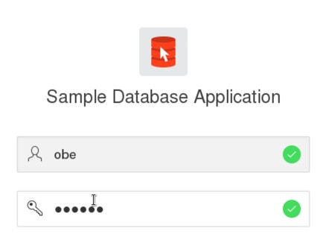
“edition aware” app
COPY APEX APPLICATION
App ID 100 = BASE App ID 110 = BETA App ID 120 = ALPHA
change pages

Slide 14
configure ORDS pools
XML FILES
defaults.xml
setup —databases add service name copy&paste
configuration file | purpose
defaults.xml | common settings, defaults for all connection pools
conf/apex.xml | APEX_PUBLIC_USER configuration for APEX
conf/apex_al.xml | APEX_LISTENER read repository/rest configuration
conf/apex_rt.xml | APEX_REST_PUBLIC_USER apex REST services
conf/apex_pu.xml | ORDS_PUBLIC_USER Plsql and SQL developer REST services
role-mapping.xml | map web server roles to RESTful roles
url-mapping.xml | maps url to connection pools

Slide 15
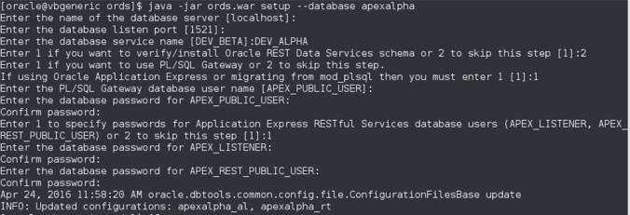


configure ORDS connection pools
COMMANDS
java -jar ords.war
setup
--database
apexalpha
<?xml version="1.0" encoding="UTF-8" standalone="no"?>
<!DOCTYPE properties SYSTEM "http://java.sun.com/dtd/properties.dtd">
<properties>
<comment>Saved on Fri Jan 22 17:12:18 EST 2016</comment>
<entry key="db.password">@05F6F3ABB32550C3BD33C3358A775868E1</entry>
<entry key="db.username">APEX_PUBLIC_USER</entry>
<entry key="db.servicename">DEV_ALPHA</entry>
<entry key="debug.debugger">true</entry>
<entry key="debug.printDebugToScreen">true</entry>
<entry key="jdbc.InitialLimit">2</entry>
</properties>

Slide 16
map URL to database pool
COMMANDS
java -jar ords.war
map-url
—type
base-path
alpha
apexalpha
<?xml version="1.0" encoding="UTF-8"?>
<pool-config xmlns="http://xmlns.oracle.com/apex/pool-config">
<pool name="apexalpha" base-path="alpha" updated="2016-04-22T06:17:08.423Z"/>
<pool name="apexbeta" base-path="beta" updated="2016-04-22T06:17:08.423Z"/>
<pool name="apexbase" base-path="base" updated="2016-04-22T06:17:08.423Z"/>
</pool-config>

Slide 17
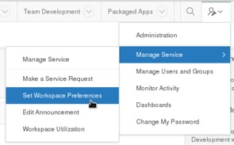

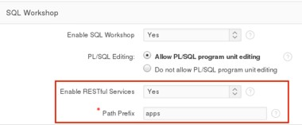

Ressource Templates
ENABLE REST IN WORKSPACE
set workspace preferences choose path prefix

Slide 18
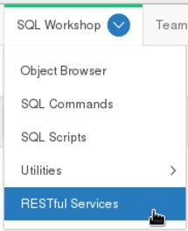
Ressource Templates
CREATE RESTFUL SERVICE
SQL Workshop / RESTful services create service module
GET plsql handler no secure access
out parameter binding url as location
html redirect code 301
Test
check network

Slide 19
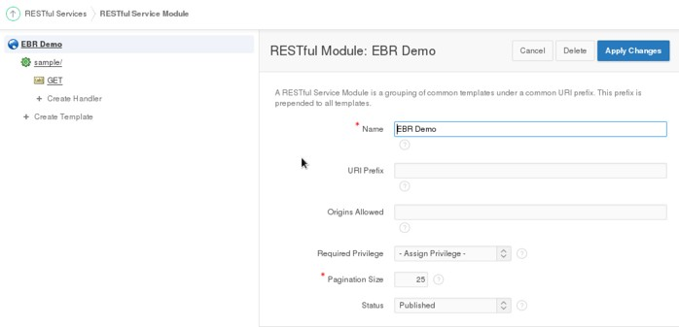
Ressource Templates
CREATE RESTFUL SERVICE
create service module
no URI prefix = general handler

Slide 20
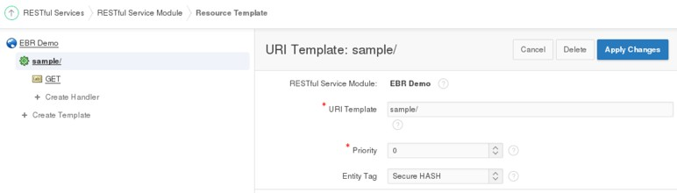
Ressource Templates
CREATE RESTFUL SERVICE
create URI Template sample/

Slide 21
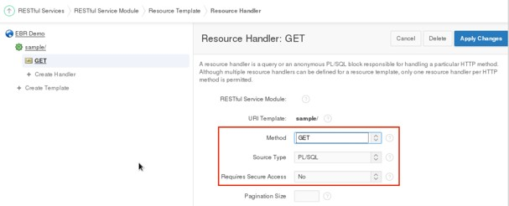
Ressource Templates
CREATE RESTFUL SERVICE
create URI Template ressource handler
GET PLSQL
no secure access

Slide 22
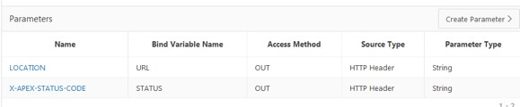
Ressource Templates
CREATE RESTFUL SERVICE
create URI Template ressource handler
set plsql source create OUT parameter
LOCATION
X-APEX-STATUS-CODE
declare
url varchar2(4000);
dbedition varchar2(100); begin
-- check context based upon current connection
dbedition := sys_context('userenv','current_edition_name');
if dbedition = 'ORA$BASE' then url := '../f?p=100';
elsif dbedition = 'DEV$BETA' then url := '../f?p=110';
elsif dbedition = 'DEV$ALPHA' then url := '../../f?p=120';
else -- use default application url := '../f?p=110';
end if;
:URL := url;
:STATUS := 301; --redirect end;

Slide 23
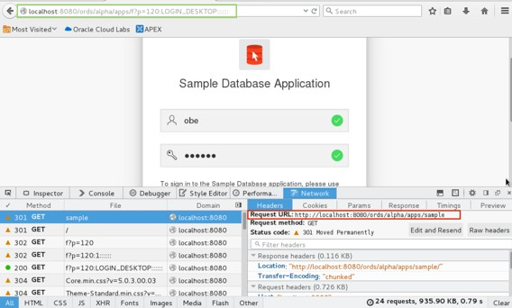
Ressource Templates
CREATE RESTFUL SERVICE
TEST

Slide 24
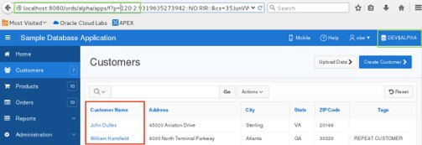
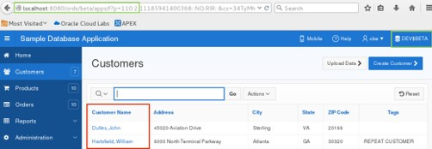


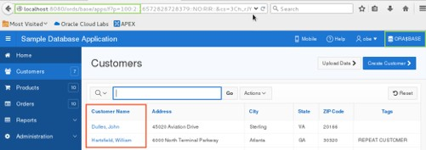

Final Result
TRY THE APPLICATION

Slide 25



Architecture
use EBR
to save a test database

Slide 26





DB and SVN setup
EDITION ARCHITECTURE
DEV
TST
PRD
release creation and acceptance test
reviews and automated unit
testing
ORA$BASE
ORA$BASE
PRD$RELEASE1
Editions
on demand deployment
DEV$BETA
Integrations and Deployment Test
PRD$RELEASE2
development
DEV$ALPHA
PRD$TMP1
nightly BETA builds
PRD$TMP2
Subversion
repository for artefacts
nightly automated SVN backup
PRD$TMP3
manual release build

Slide 27
Fazit
RECOMMENDATIONS
Negative downtime is better than zero downtime! Install and run different application version in parallel
Use it during development and save up on test databases choose url pathname different from schema name

Slide 28
Want to know more?
LINKS
Oracle Documentation https://docs.oracle.com/database/121/ADFNS/adfns_editions.htm#ADFNS020
Bryn Llewellyn http://www.oracle.com/technetwork/database/features/availability/edition-based- redefinition-1-133045.pdf
Tom Kyte: “A closer look at the New Edition” http://www.oracle.com/technetwork/issue-archive/2010/10-jan/o10asktom-172777.html
Chris Saxon https://www.doag.org/formes/pubfiles/7321069/docs/Konferenz/2015/vortraege/Development/ 2015-K-DEV-Chris_Saxon-Edition_Based_Redefinition_for_Zero_Downtime_PL_SQL_Changes- Manuskript.pdf
Lucas Jellema
http://www.slideshare.net/lucasjellema/edition-based-redefinition-continuous-database- application-evolution-with-oracle-database-11g-release-2
Kris Rice
http://krisrice.blogspot.de/2013/07/nicer-urls-for-apex-yet-another-option.html http://de.slideshare.net/KrisRice/oracle-rest-data-services-best-practices-overview
Sven Weller: “Working with Editions” https://svenweller.wordpress.com/2015/03/25/working-with-editions-part-1/ https://svenweller.wordpress.com/2015/06/16/working-with-editions-part-2/ Soon to come: The Edition based “not only” Redefinition Manifesto

Slide 29
Danke
SYNTEGRIS INFORMATION SOLUTIONS GMBH
HERMANNSTRASSE 54-56
63263 NEU-ISENBURG
FON (06102) 29 86 68
FAX (06102) 55 88 06 INFO@SYNTEGRIS.DE
SYNTEGRIS.DE

